Slide 1
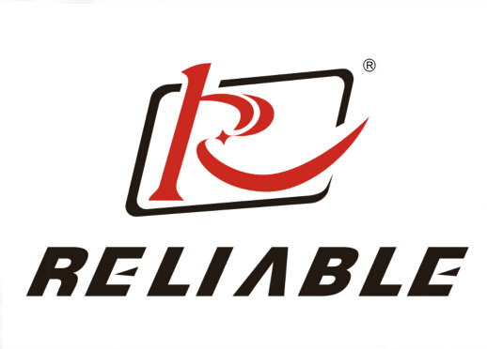
Automated Infrastructure/Construction Maintenance System
For Reliable Electronics Corp.
Abhishek Sukhadiya (20076)

Slide 2
Reliable Electronics Background
Located in the Boston City
Top producer of Electronic & Testing equipments
Multiple plants with around 10,000 Full-time employees
Around 200 employees in Maintenance department of the building, grounds and everything in corporation
Notes:
Maintenance has assigned a group of employees to provide maintenance for each building or plant. Maintenance Department- Carpenters, Electricians, Painters, Welders, Plumbers, Special Skills, etc.

Slide 3
Problem Statements
Equipment Depot Operations
Facilitates equipments
Check-out and check-in(on return) quipments
Pieces of equipment boxes become lost / stolen / damaged
Estimated $50,000 worth of tools are lost and stolen each year
Material Warehouse Operations
2 operating locations for warehousing
Lack of coordindation in managing goods
in smaller and most accessed warehouse
Notes:
In September of 2018, Will Baxter and his management staff completed a 1-week analysis aimed at assessing the maintenance operations. The most important initiatives were- …… The equipment depot's function is to provide the equipment needed by maintenance employees to perform their job duties. Employees are provided with a toolbox containing commonly used and relatively inexpensive tools, such as hammers, screwdrivers, tape measures, and so on. Other tools and pieces of equipment that are needed to complete a job must be checked out through the equipment depot. When the job is completed, the employee must return the checked-out equipment.
Often, pieces of equipment become lost, stolen, or damaged and are therefore never checked back in and made available for others. The net result is excessive inventory and inventory carrying costs due to excessive order placed by the employees without checking the availability of the equipments in the Main Warehouse.

Slide 4
Proposed Solution
Automated Equipment Checkout System
Improved Warehouse System
Notes:
development of a new, automated equipment checkout system that will track the check-in and check-out of equipment. a new and improved warehousing system is another top priority for the maintenance department.

Slide 5
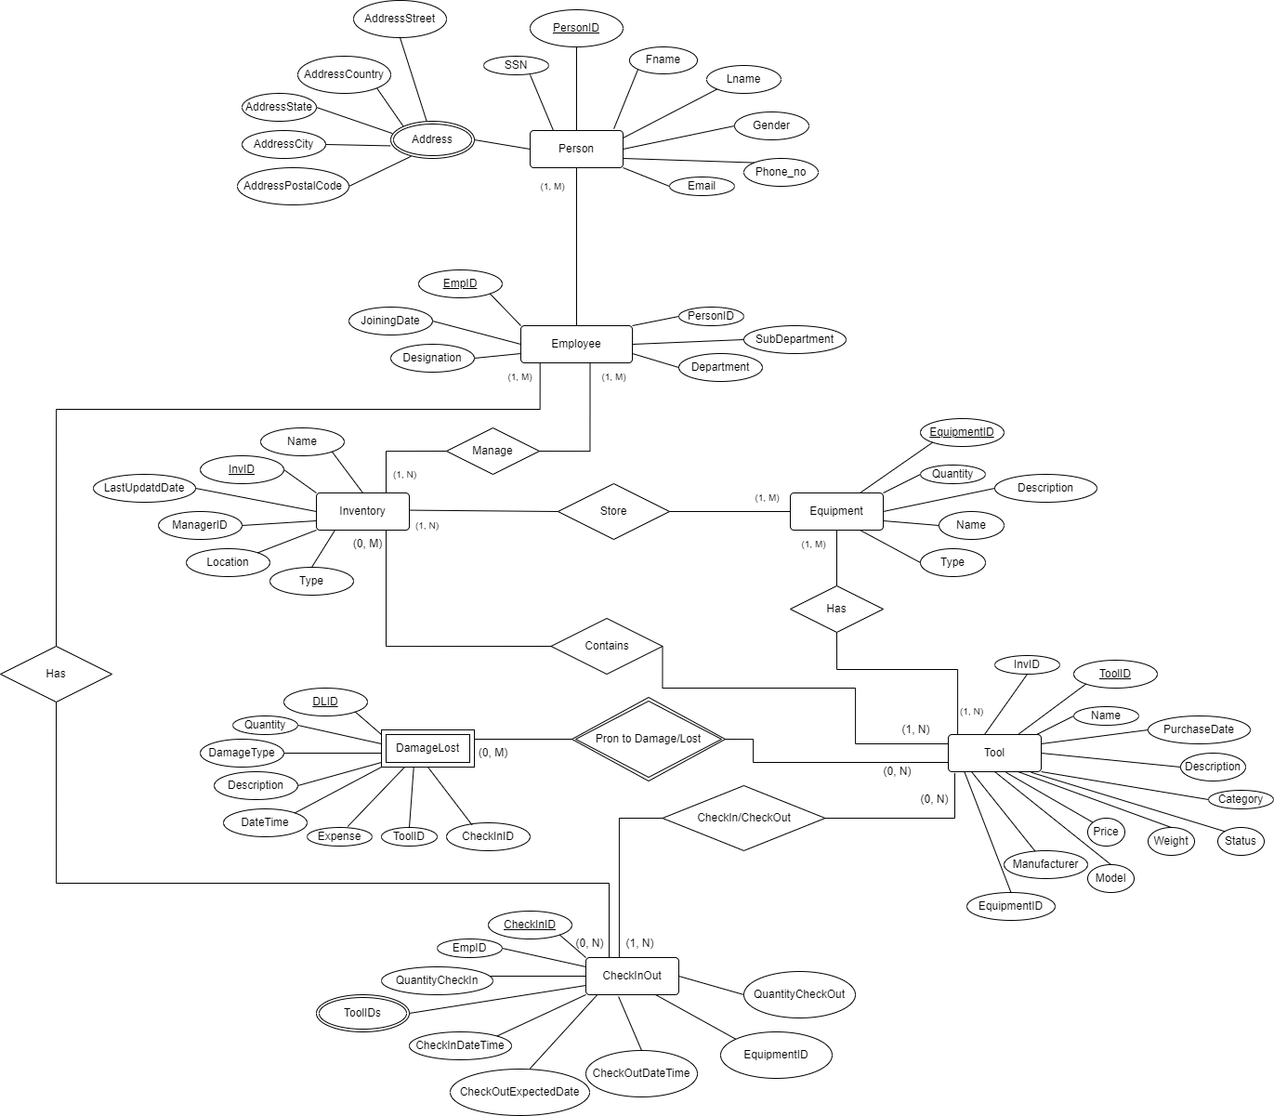
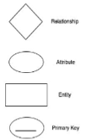



Proposed ER Diagram
Legends

Slide 6
Relationships
A Person and an Employee - 1 to 1 relationship
Employee manages Inventory - M to 1 relationship
Inventory stores Equipment/s - 1 to M relationship
Equipment has Tool/s - M to M relationship
Inventory contains Tool/s - M to M relationship
Employee has CheckIn/CheckOut - 1 to M relationship

Slide 7
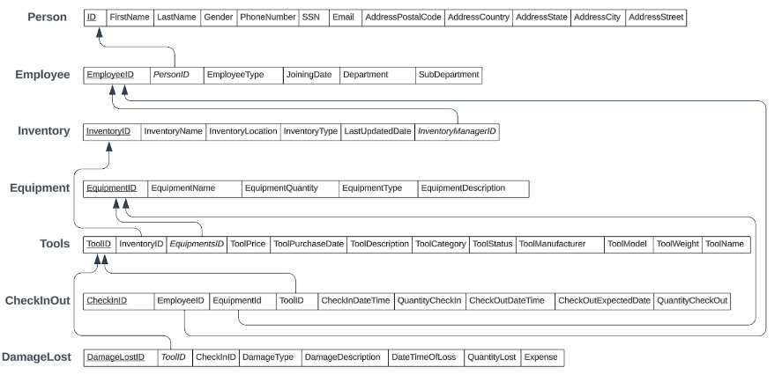
Proposed Relational Schema

Slide 8
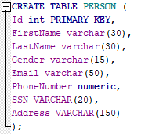
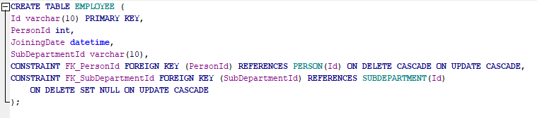

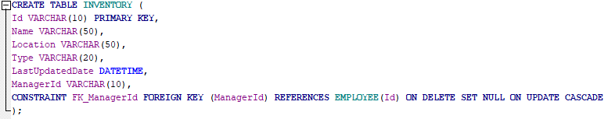
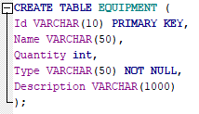

Relations

Slide 9
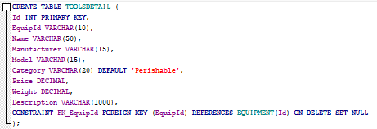
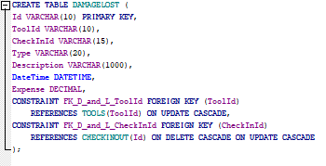
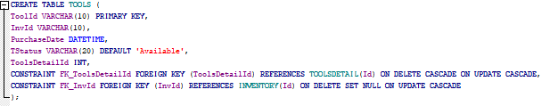
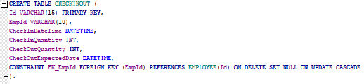
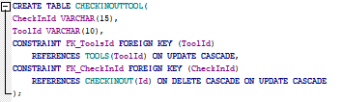
Relations

Slide 10
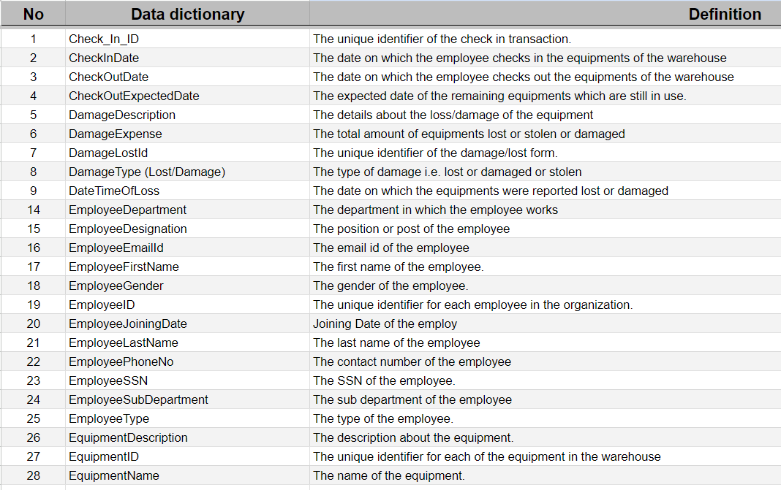
Data Dictionary
Notes:
development of a new, automated equipment checkout system that will track the check-in and check-out of equipment. a new and improved warehousing system is another top priority for the maintenance department.

Slide 11
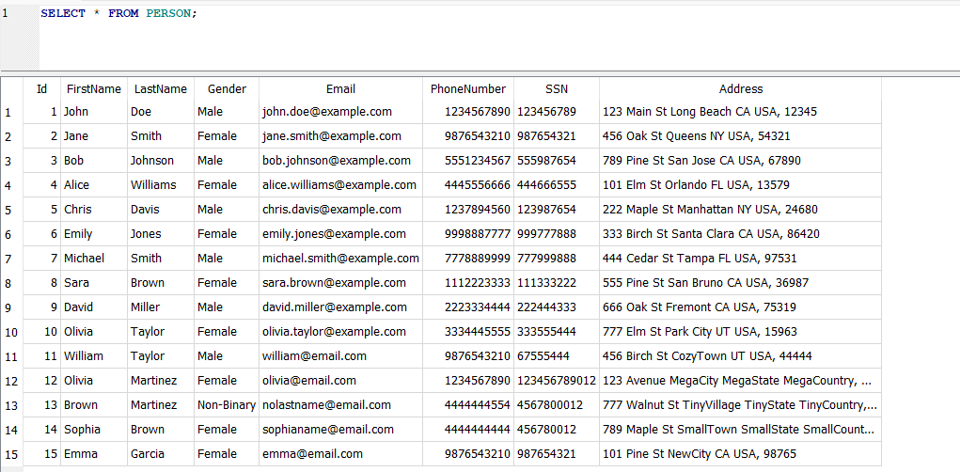
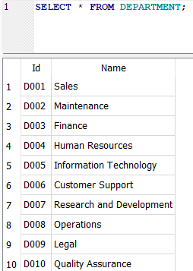
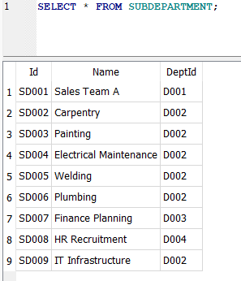
Schemas

Slide 12
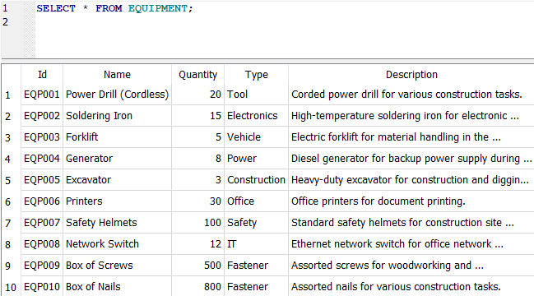
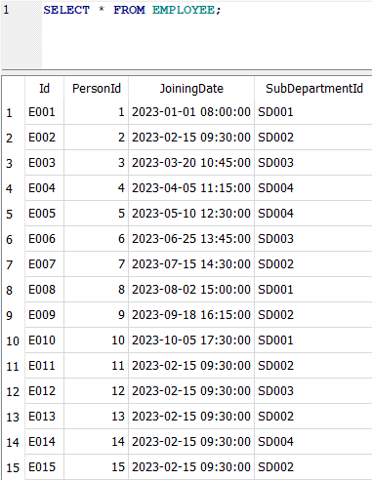
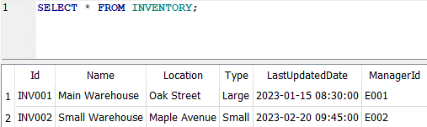
Schemas

Slide 13
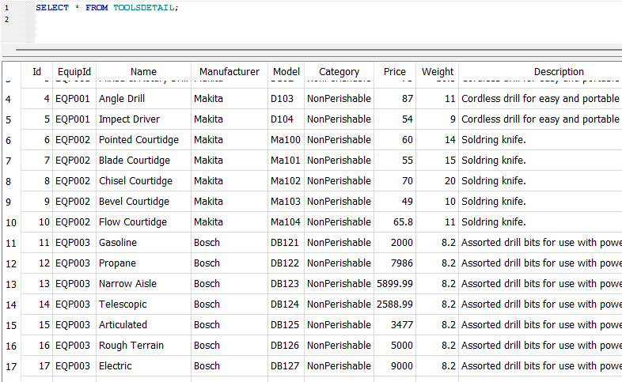
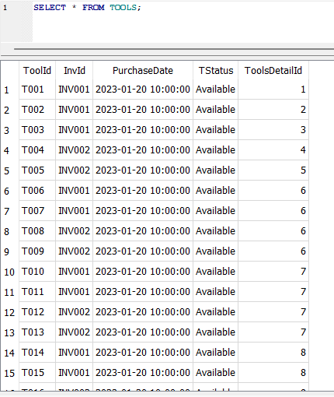
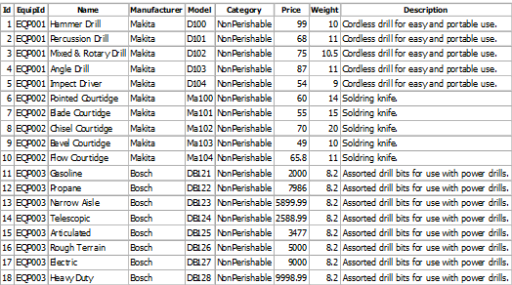
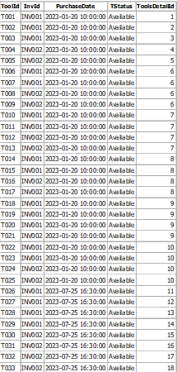
Schemas

Slide 14
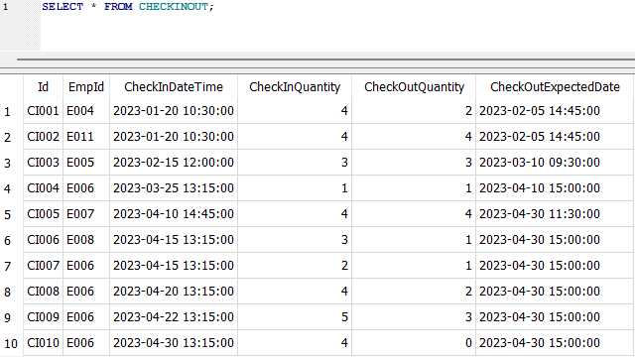
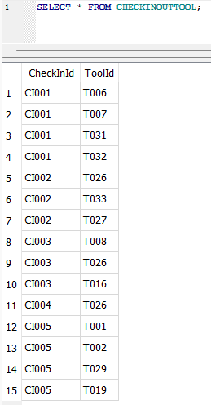
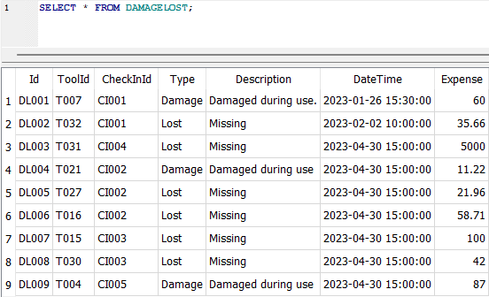
Schemas

Slide 15
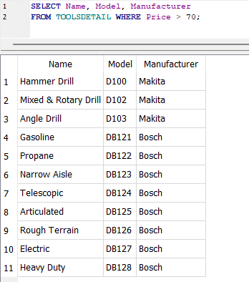
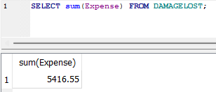
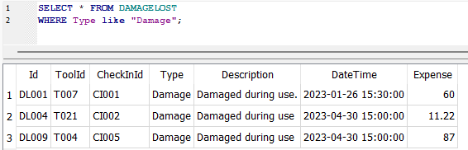
Queries (Basic)
Retrieve Tools with basic details with price more than 70$
Retrieve the total amount of expenses
Retrieve Tools with having Damage under usage

Slide 16
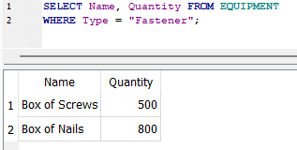
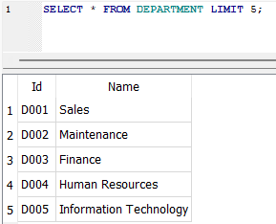
Queries (Basic)
Retrieve all Equipments with Fastener as type
Retrieve first 5 departments in the list

Slide 17
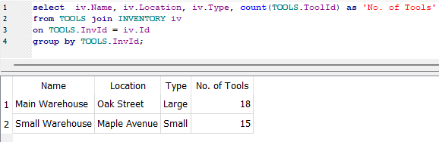
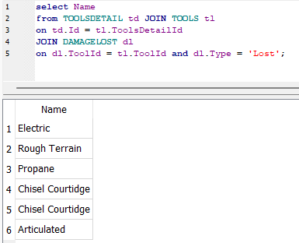
Queries (Intermediate)
Retrieve the list of inventory details with no of tools
Retrieve list of the lost items

Slide 18
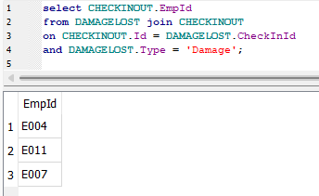
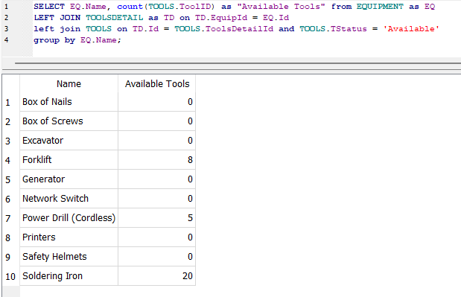
Queries (Intermediate)
Retrieve the list of EmployeeId who made Damage
Retrieve the list of available tools of the Particular type

Slide 19
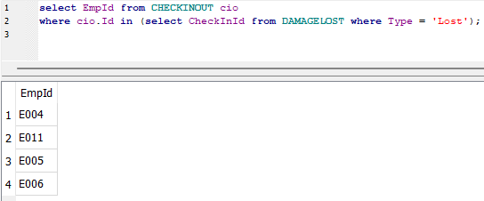
Queries (Intermediate)
Retrieve the list of EmployeeId who made Lost

Slide 20
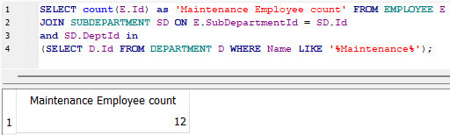
Queries (Advanced)
Retrieve the number of the Maintenance Employee

Slide 21
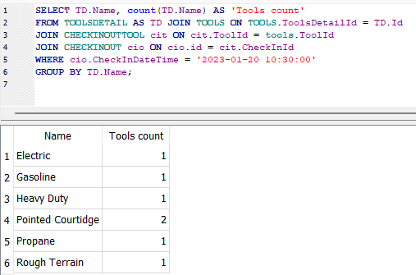
Queries (Advanced)
Retrieve the list of tools checking on the Particular date

Slide 22
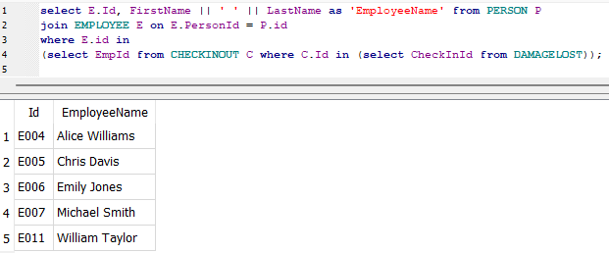
Queries (Advanced)
Retrieve the list of Employee who made Damage or Lost

Slide 23
Queries (Advanced)
Retrieve the number of the Maintenance Employee
Retrieve the list of Employee who made Damage or Lost

Slide 24
Mathematical Notations
SELECT Name, Model, Manufacturer FROM TOOLSDETAIL WHERE Price > 70;
SELECTED_TOOLS ← σ _{Price > 70} ( TOOLSDETAIL (Name, Model, Manufacturer))
SELECT * FROM DAMAGELOST WHERE Type="Damage";
DAMAGED_TOOLS ← σ _{Type =”Damage”} ( DAMAGELOST)
SELECT Name, Quantity FROM EQUIPMENT WHERE Type = "Fastener";
FASTENER_TOOLS ← σ _{Type =”fastener”} (EQUIPMENT(Name, Quantity))

Slide 25
Mathematical Notations (continued)
SELECT iv.Name, iv.Location, iv.Type, count(TOOLS.ToolId) as 'No. of Tools' from TOOLS
join INVENTORY iv on TOOLS.InvId = iv.Id;
rs ← σ (I.Name, I.Location, I.Type, COUNT(T.ToolId)) (TOOLS T(InvId) ∩ INVENTORY I(Id))
SELECT Name from TOOLSDETAIL JOIN TOOLS on ToolsDetail.Id = TOOLS.ToolsDetailId JOIN DAMAGELOST on DAMAGELOST.ToolId = TOOLS.ToolId and DAMAGELOST.Type = 'Lost';
rs ← π _{Name} (TOOLSDETAIL TD _{TD.d = T.ToolsDetailId} TOOLS T (DL.ToolId =T. ToolId AND DL.Type=”lost”) DAMAGELOST DL)

Slide 26
Challenges and Learnings
Challenges faced
Deciding on what all tables we actually needed to implement.
Data entry for tools and the category of the tools which are need during the maintenance.
Multiple table connection with cascade operation.
Learnings
Clarity about implementation of Functional Dependency

Slide 27
Conclusion
Automated Equipment Checkout System
Better tracking of tools and equipments
Reduced loss/damage of tools and equipments
Enhanced Warehouse System
Controlled equipment expenses
Streamlined equipments’ order

Slide 28
References
https://www.reliablelectronics.com/Reduced loss/damage of tools and equipments
https://electronicpartsdistributor.com/

Slide 29
Thank you

